Slide 1

DIGITAL PORTFOLIO
STUDENT NAME: Kavitha T
REGISTER NO AND NMID: astuv 30430424u18001
DEPARTMENT: B.SC computer science
COLLEGE: Arignar Anna govt. art's and science college, walaja
UNIVERSITY: Thiruvalluvar university

Slide 2

PROJECT TITLE
Empowering Education with
digital portfolio

Slide 3

AGENDA:
Problem Statement
Project Overview
End Users
Tools and Technologies
Portfolio design and Layout
Features and Functionality
Results and Screenshots
Conclusion
Github Link

Slide 4

PROBLEM STATEMENT
1. Skill Showcase Gap Traditional resumes fail to capture creativity, skills, and real-world projects, leaving students unable to demonstrate their true potential.
2. Lack of Online Presence
Many students lack a structured digital space to highlight achievements, creating a barrier between talent and opportunities.
3. Outdated Methods
Certificates and CVs are static, offering limited engagement in a digital-first world

Slide 5


4. Accessibility & Visibility
Without a dynamic platform, student achievements remain unnoticed, reducing chances for growth and recognition.
5. Talent-Opportunity Mismatch
The absence of interactive portfolios widens the gap between what students can do and what recruiters/academics can see

Slide 6

PROJECT OVERVIEW
This project focuses on creating a Digital Portfolio as an innovative tool to empower education. The portfolio serves as a personal space where students and professionals can showcase their skills, achievements, academic projects, and personal growth journey in an organized digital format.
The portfolio contains the following sections:
About Me - Introduction, background, and goals.

Slide 7
Projects - Key academic or professional projects with descriptions and outcomes.
Skills - Technical, academic, and soft skills represented effectively.
Contact - Easy ways for teachers, peers, or employers to connect.
The main idea is to encourage self-learning, creativity, and confidence by giving individuals a platform to present their work digitally. This not only enhances communication skills but also helps in career readiness, higher education opportunities, and personal branding

Slide 8

WHO ARE THE END USERS?
1. Students –
They are the primary end users.
Use digital portfolios to collect, reflect, and showcase their learning, skills, and progress.
2. Teachers/Educators –
They act as facilitator end users.
Use digital portfolios to assess students’ growth,
3. Parents/Guardians – They are secondary end users. Access portfolios to monitor and support their child’s learning journey

Slide 9
4. Institutions/Administrators – Use them for curriculum planning, accreditation, and evaluating teaching effectiveness.
👉 So, the main end users are students and teachers, while parents and institutions are supportive/indirect end users.

Slide 10

TOOLS🛠️:
LMS: Google Classroom, Moodle Portfolio Apps: Seesaw, Mahara, Portfolium Cloud & Collab: Google Drive, OneDrive, Teams Creative Tools: Canva, Padlet, Wakelet Feedback Tools: Kahoot, Mentimeter

Slide 11
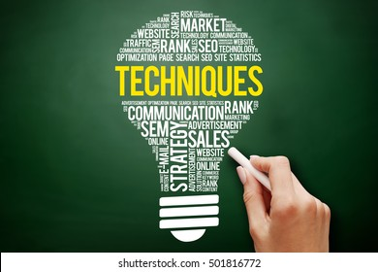
Techniques🎯:
Student-centered & reflective learning
Project-based learning
Goal setting & skill tracking
Peer review & collaboration
Showcasing achievements & career readiness

Slide 12
POTFOLIO DESIGN AND LAYOUT
Header: Navigation bar
About Me: Education + career goals
Skills Section: Academic & technical skills
Projects Showcase: Images + details
Achievements/Certificates: Awards & recognition
Reflections: Learning journey & growth
Contact Section: Email, phone, Linkedin

Slide 13

Simple, clear structure that
empowers learners
by showing skills, growth,
and achievements.

Slide 14
FEATURES AND FUNCTIONALITY
✨♡FEATURES:
Multimedia support (text, images, audio, video)
Cloud-based storage & easy access
Personalization & creative design
Progress tracking & reflections
Sharing & collaboration options
Secure data and privacy

Slide 15
⚙️ Functionalities:
Collecting and organizing student work
Self-assessment & teacher feedback
Peer review & collaboration
Showcasing achievements and skills
Linking to career or higher studies

Slide 16

RESULTS AND SCREENSHOTS
Screenshot of
Screenshot of my about
Screenshot of project section
3/21/2024 Annual Review
16

Slide 17
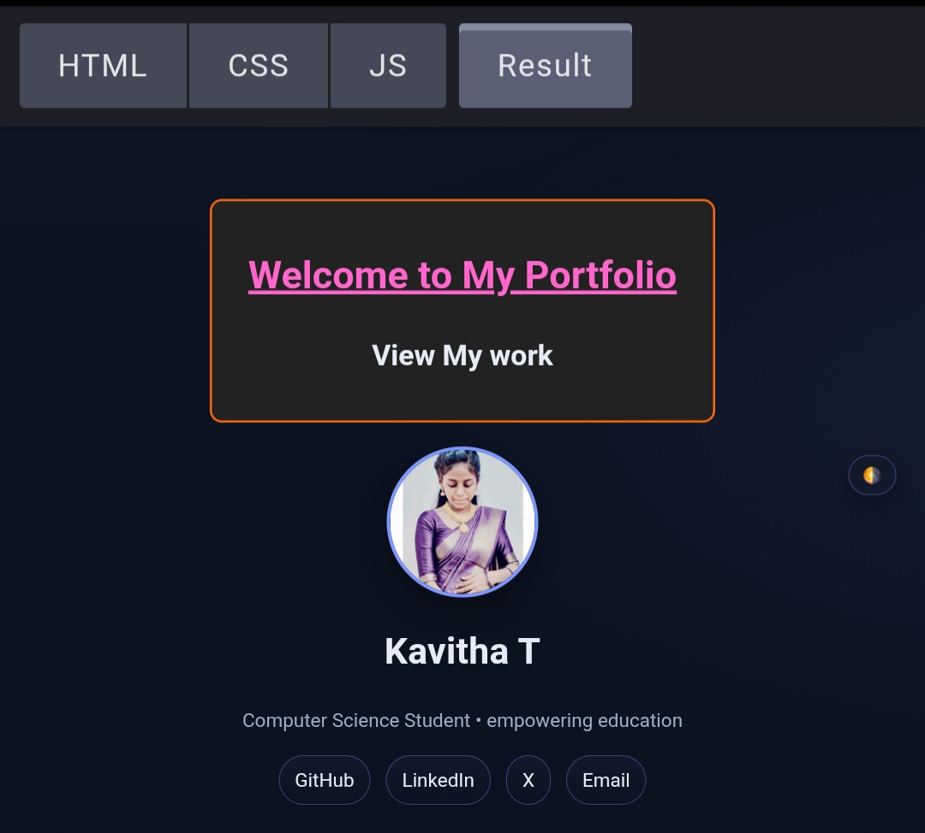
Screenshot:

Slide 18
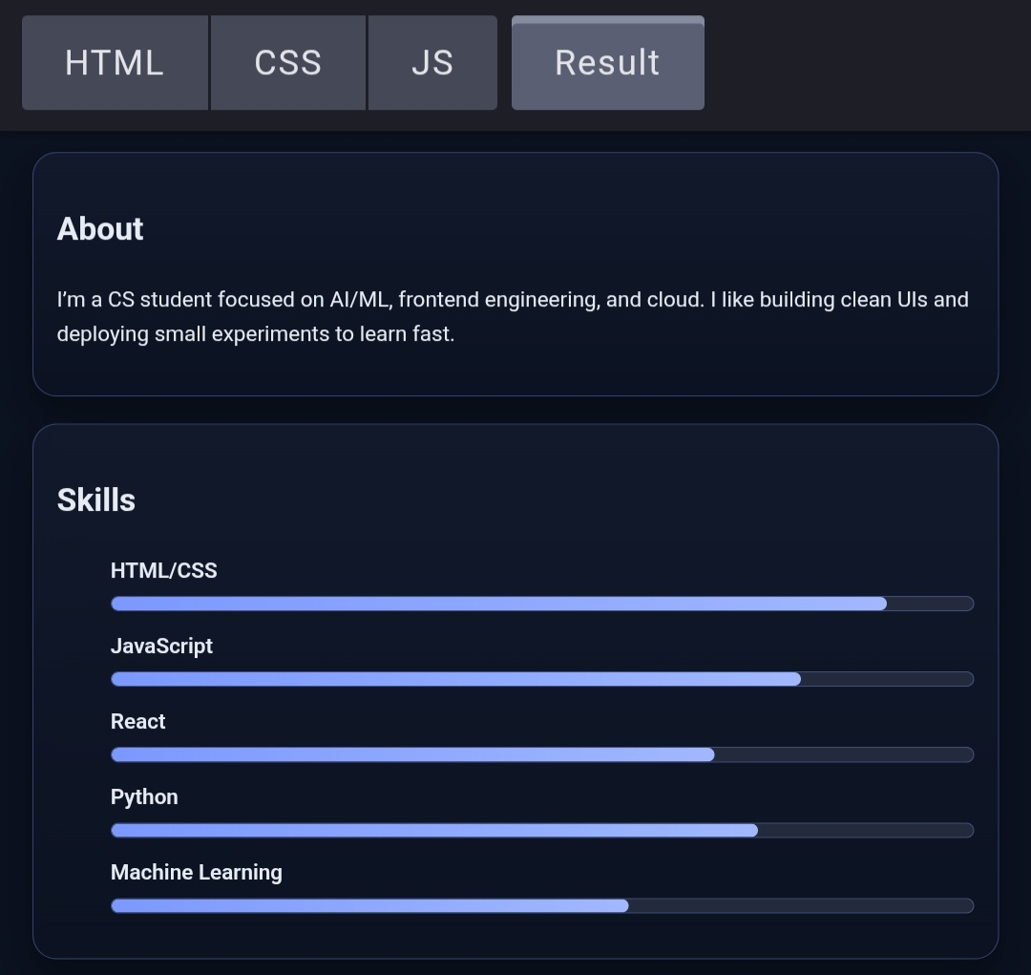

Slide 19
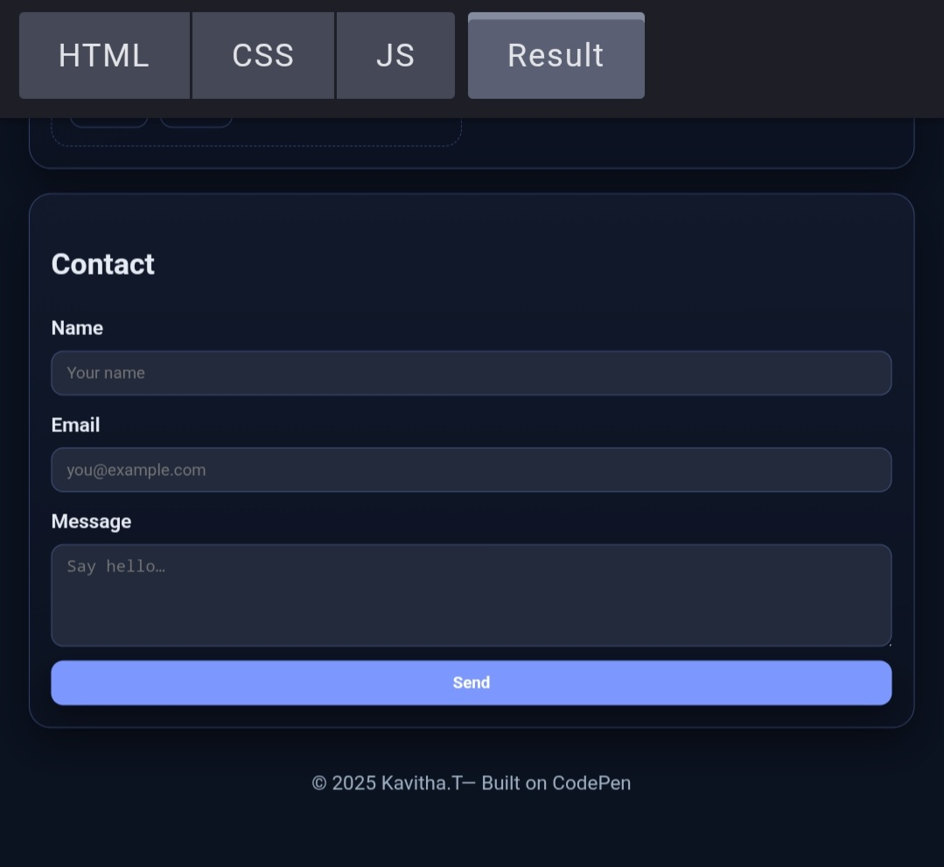

Slide 20
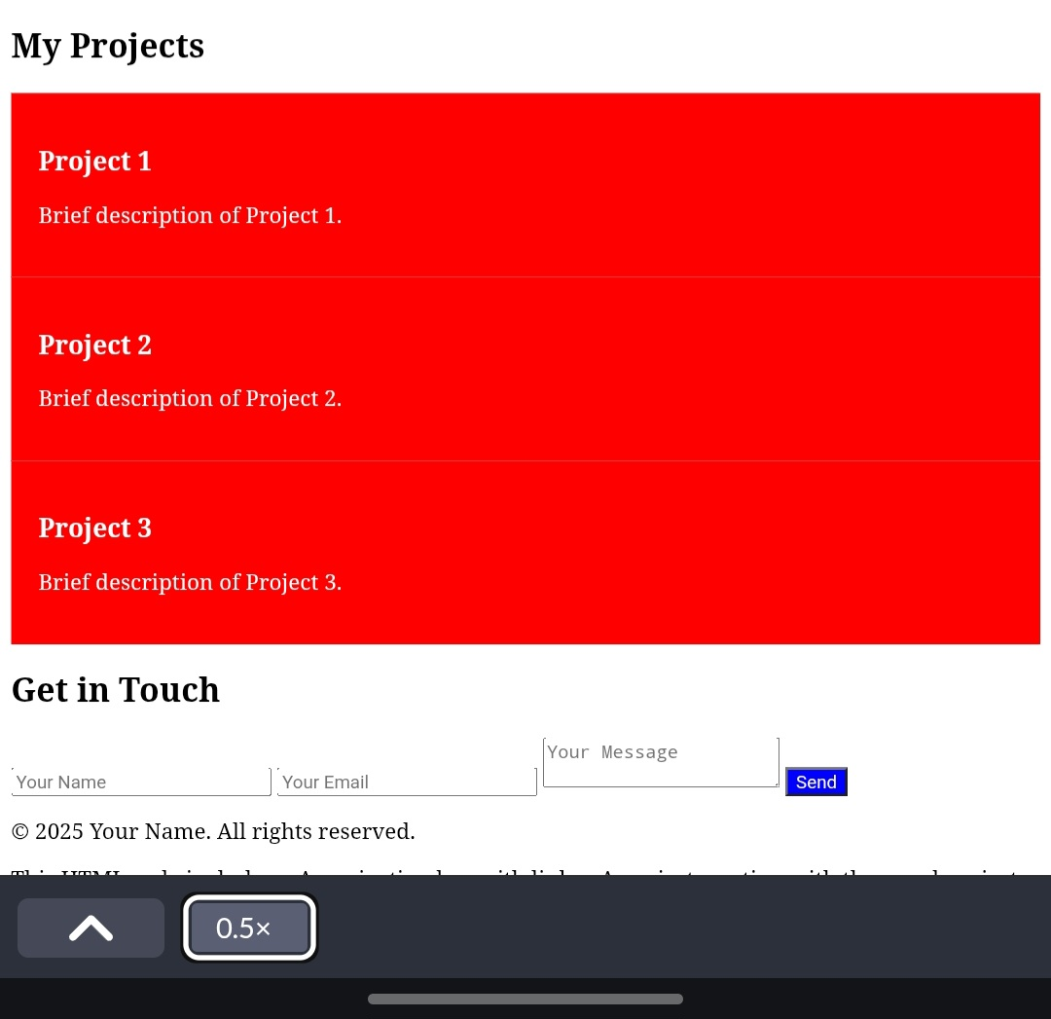

Slide 21
CONCLUSION
Finally, I finished my digital portfolio project using HTML,CSS and Javascript.
My project is perfectly good and awesome.
Have you ever wondered if marks alone can reflect a student’s true learning? 🤔
Digital portfolios provide a broader picture of skills, creativity, and progress
They empower students to reflect, improve, and take ownership of their learning.Teachers and parents gain deeper insights beyond grades.
Encourage lifelong learning, collaboration, and adaptability in the digital era.
Bridges traditional education with modern technology for holistic growth.
21

Slide 22


GITHUB LINK:
https://github.com/kavi5670583-NM/TNSDC-FWD-DP.git

Slide 23


